Slide 1
Test interface/request form

Slide 2

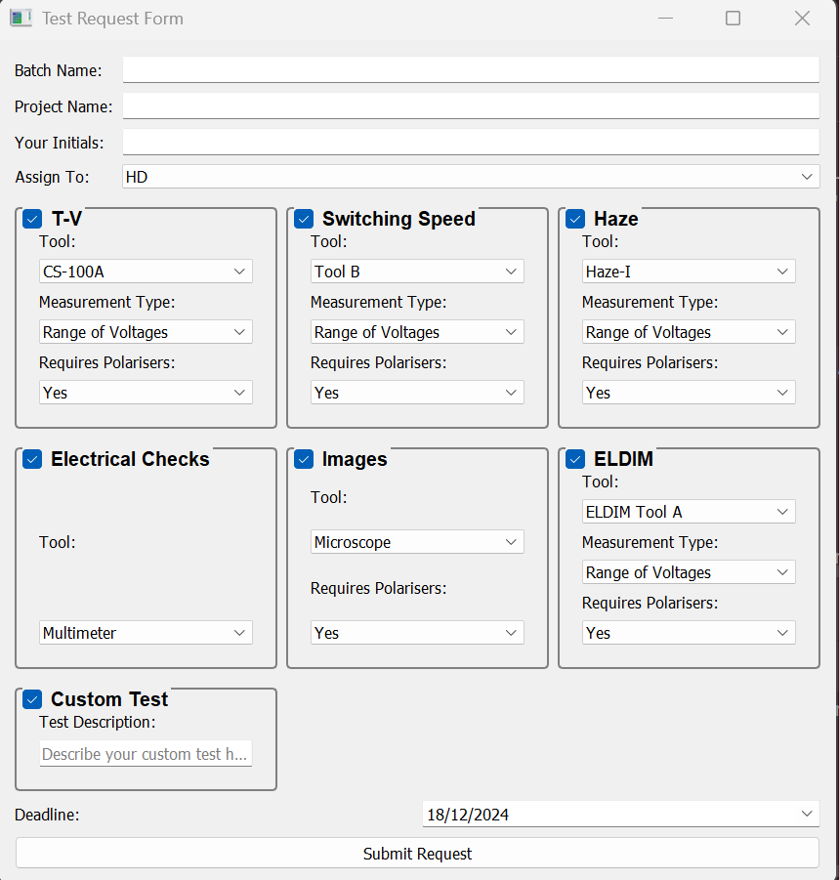


Architecture
T:\data\R\RXXX
Batch owners
Test interface
RXXX Test details
RXXX Test details
.exe
.exe
RNNN Test details
.exe
.exe
T:\pilot_line\Test scheduling
Optical test WIP
Overall dashboard
Test capabilities

Slide 3
Options
Transmission | option1 | option2 | option3
Polariser | Single | Double | orientation
Voltage | Range | Single Points
Tool | Konica Minolta CS-160S | Laser-Photodiode
Switching Speed | option1 | option2
Polariser | Single | Double
Voltage | Single points
Tool | Laser-Photodiode
Haze | option1 | option2
Polariser
Voltage | Range | Single Points
Tool | Old Haze Gard | New Haze Gard

Slide 4
Test Instances and block diagrams for testing instructions
Select test (dropdown)
Methods
Example instances
Images
Images
Polarisers
Type: Normal
Lamination: loose
Number of polarisers: 2
Orientation of pol1: 0deg
Orientation of cell: 45deg
Orientation of pol2: 90deg
Voltage
Range: Nan
Single Point: 50V
Sweep: Nan
Tool
Imaging setup: Nikon Camera
Angle of incidence: On-axis
Notes
Add any comments or additional tests here
Polarisers
Type: Normal
Lamination: loose
Number of polarisers: 2
Orientation of pol1: 0deg
Orientation of cell: 45deg
Orientation of pol2: 90deg
Voltage
Range: Nan
Single Point: 0V
Sweep: Nan
Tool
Imaging setup: Nikon Camera
Angle of incidence: On-axis
Notes
Add any comments or additional tests here
Images
Transmission
Haze
Switching Speed
Pretilt
Electrical checks
Microscopy
Interferometry
Reflectance
Custom or new
Failure Analysis
Polarisers
Type
lamination
Number of polarisers
Orientation
Voltage
Range
Single Point
Sweep
Tool
Sample number

Slide 5
Test Instances and block diagrams for testing instructions
Transmission
Transmission
Switching Speed
Electrical Checks
Polarisers
Type: Normal
Lamination: loose
Number of polarisers: 0
Orientation of pol1: Nan
Orientation of cell: Nan
Orientation of pol2: Nan
Voltage
Range: 0-50V
Single Point: Nan
Sweep: F+R
Tool
Setup: Colorimeter CS-160S
Angle of incidence: On-axis
Notes
Add any comments or additional tests here
Sample Number (#)
Qty:
Notes:
Polarisers
Type: Normal
Lamination: loose
Number of polarisers: 0
Orientation of pol1: Nan
Orientation of cell: Nan
Orientation of pol2: Nan
Voltage
Range: Nan
Single Point: 0V
Sweep: F+R
Tool
Setup: Perkin Elmer UV-VIS
Angle of incidence: On-axis
Notes
Add any comments or additional tests here
Sample Number (#)
Polarisers
Type: Normal
Lamination: loose
Number of polarisers: 0
Orientation of pol1: Nan
Orientation of cell: Nan
Orientation of pol2: Nan
Voltage
Range: Nan
Single Point: 50V
Sweep: Nan
Tool
Setup: Laser Rig1
Angle of incidence: On-axis
Notes
Add any comments or additional tests here
Polarisers
Type: Nan
Lamination: Nan
Number of polarisers: Nan
Orientation of pol1: Nan
Orientation of cell: Nan
Orientation of pol2: Nan
Voltage
Range: Nan
Single Point: Nan
Sweep: Nan
Tool
Setup: Multimeter
Angle of incidence: Nan
Notes
Add any comments or additional tests here

